Slide 1
VIRTUAL “WHITEBOARD”
Final PRESENTATION
COMPUTER VISION
ARGENTINA ORTEGA SAINZ
NICOLAS LAVERDE ALFONSO
Jan. 15 2015

Slide 2
Introduction
Recognize the strokes made with a marker in a flat surface and to transform the strokes into drawings for later projection.
Two synchronized cameras capture snapshots simultaneously.
Process two snapshots from different perspectives to detect the position of a pre-defined marker.
Draw detected strokes and project them into a screen for visualization.

Slide 3
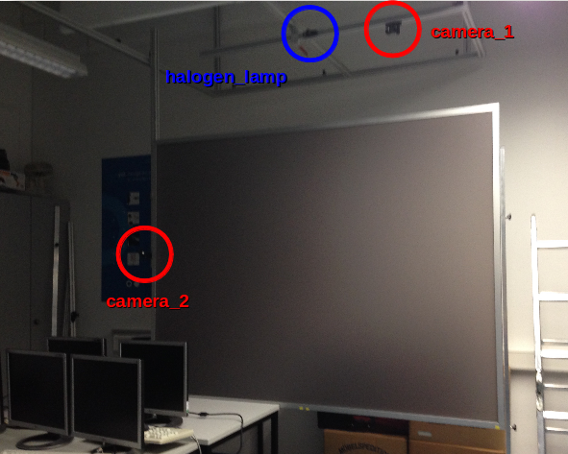
DESCRIPTION

Slide 4
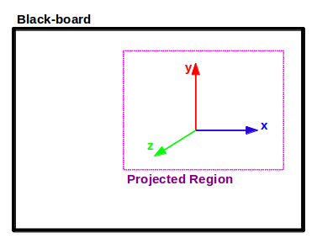
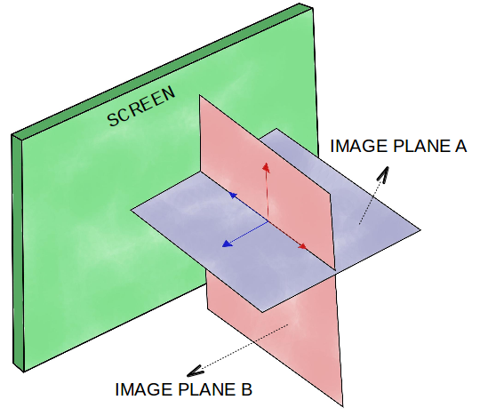
DESCRIPTION
Glass Screen
ROI

Slide 5
SYSTEM DESCRIPTION
Pixel Coordinates of the marker tip
sCam1_in
p_a = [xa,ya]
Output
sCam2_in
MARKER
DETECTOR
p_b = [xb,yb]
PAINTER
sphere_color
Intrinsic and Extrinsic parameters of the camera array.
P Matrix

Slide 6
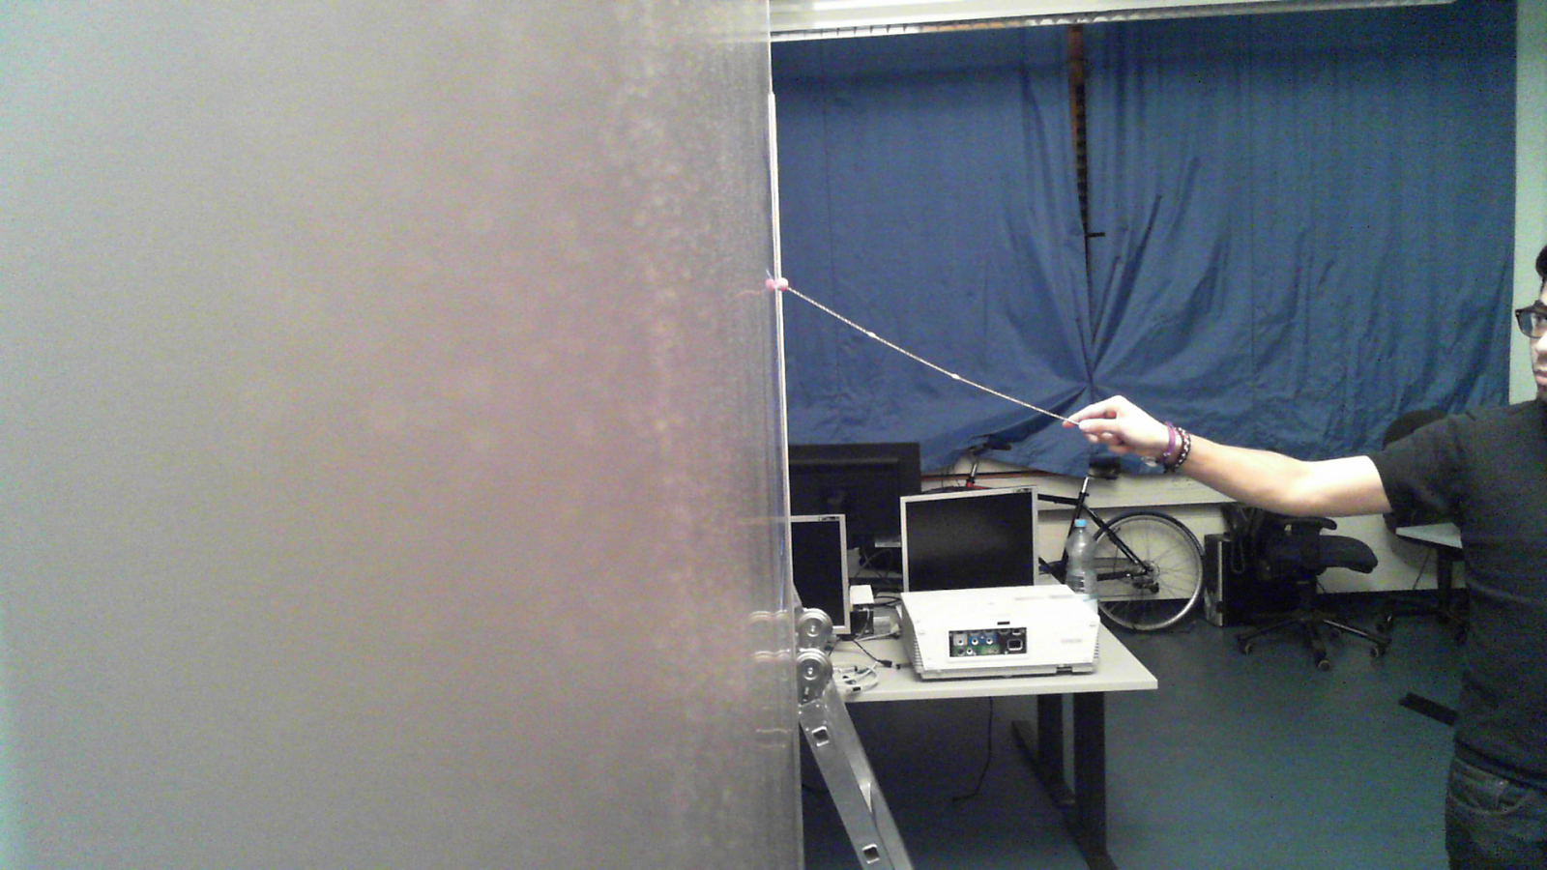
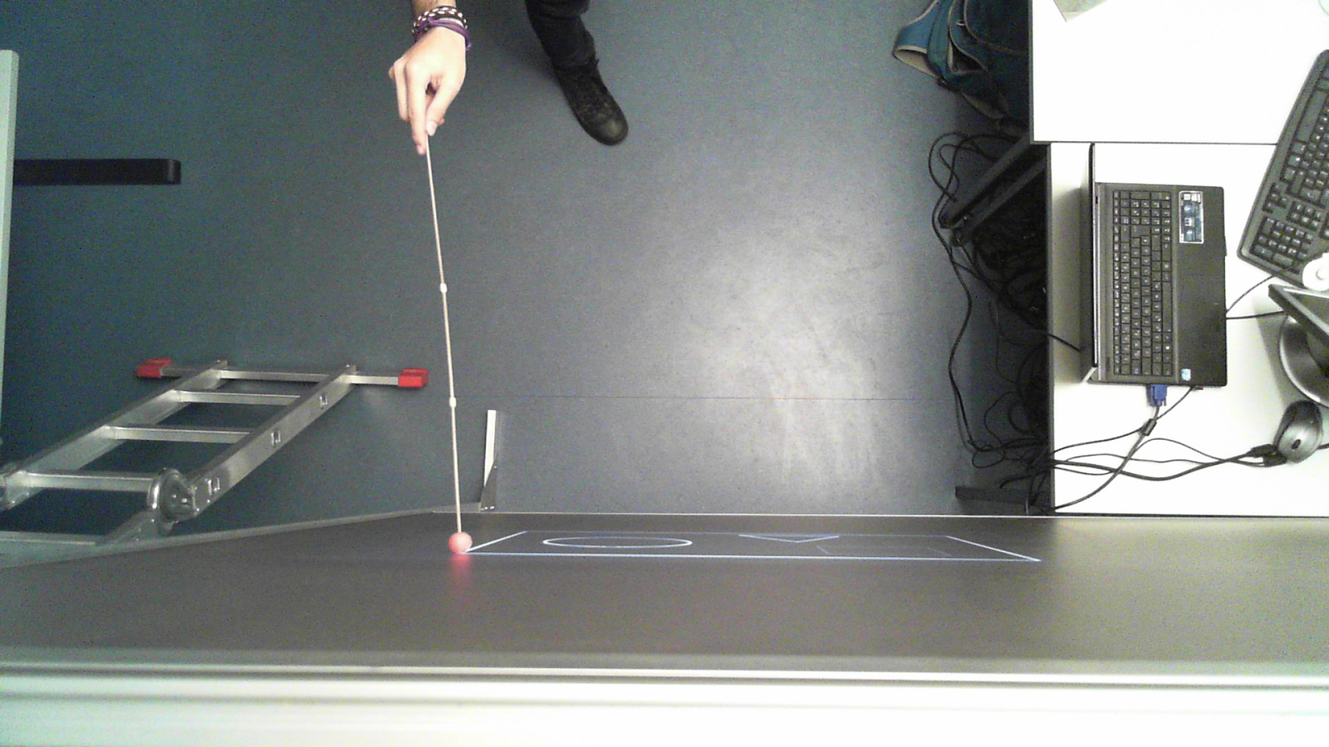
INPUT
Resolution: 1920x1080
OFFLINE DESIGN:
100 frames (images) per view.
3 sessions “recorded”, with three different colored markers (r,g,b).

Slide 7
MARKER DETECTOR SYSTEM
cam1_redux, cam2_redux
(x1, y1)
MARKER
DETECTION
(x2, y2)
CAM1
DIMENSION
REDUCTION
(ROI)
marker_crop
CAM2
color_marker
COLOR
RECOGNITION

Slide 8
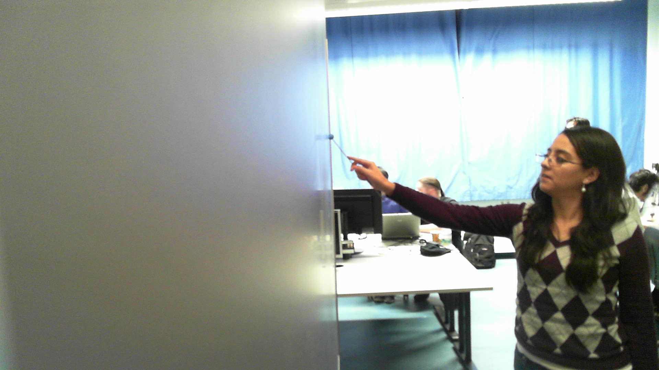
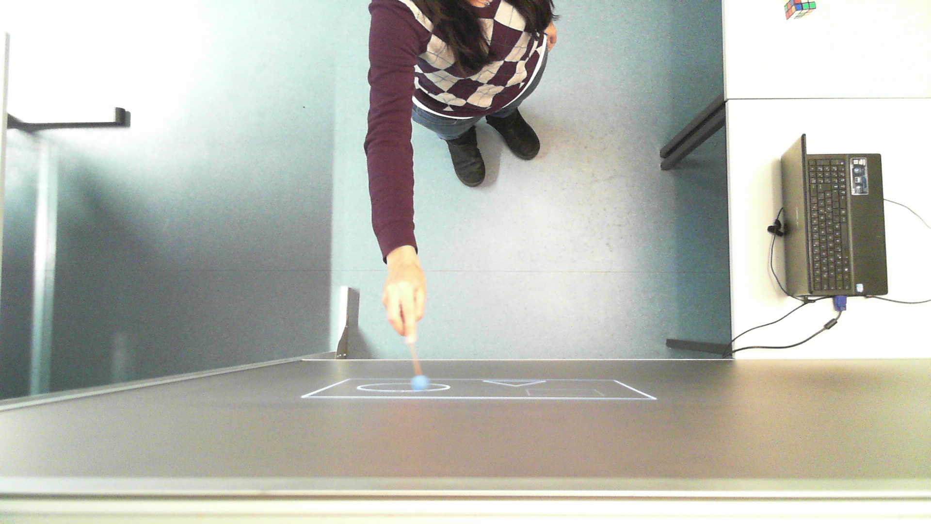
Results
Data Synchronization

Slide 9
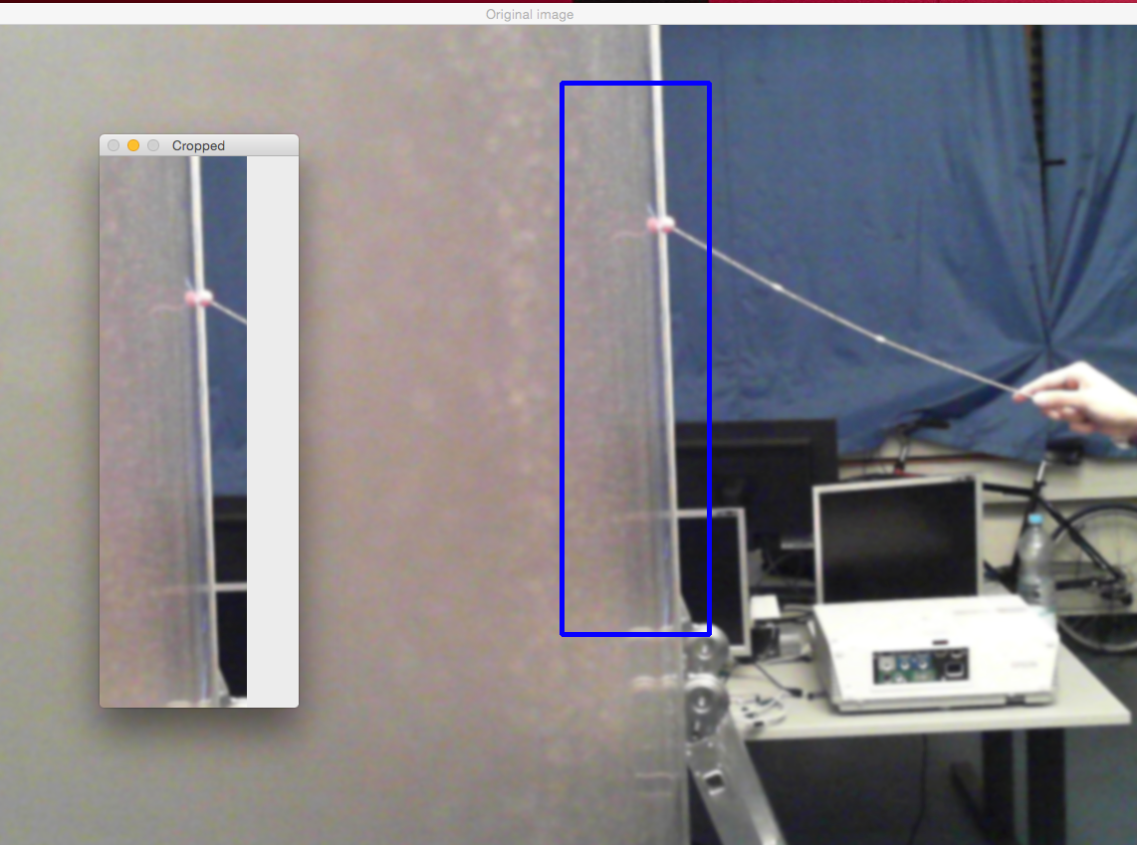

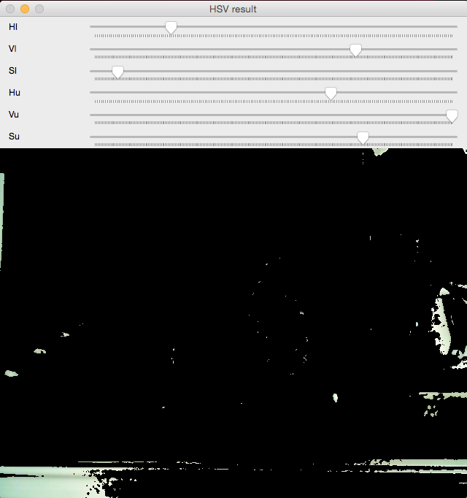
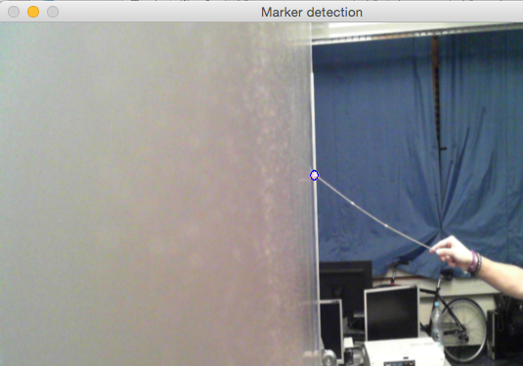
Results
MARKER DETECTION
+
+
=

Slide 10
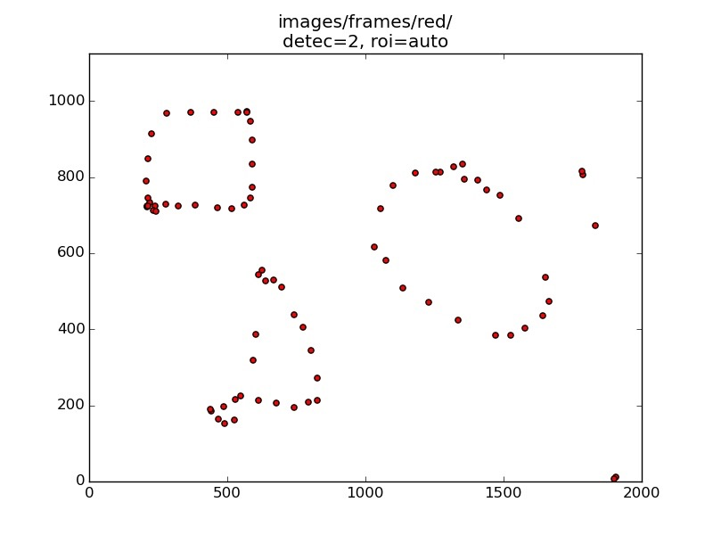
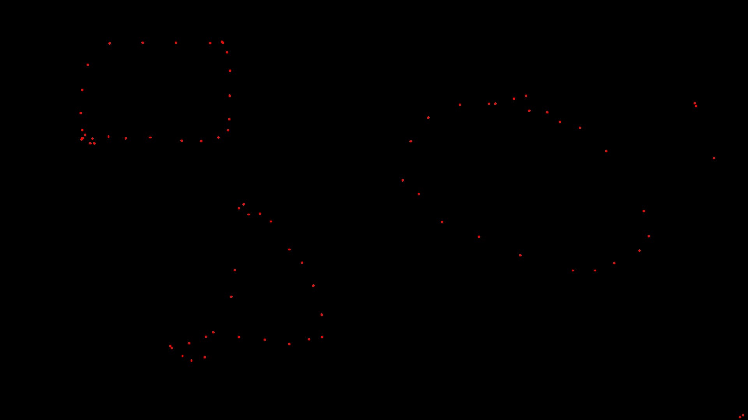
Results
Position reconstruction

